Slide 1
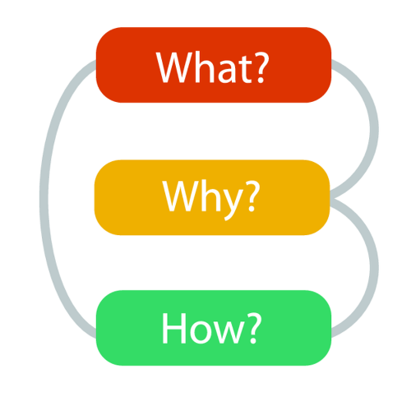

Slide 2

PROBLEM
Why some organizations are able to inspire or not.
Every organization knows what they do 100%
Some knows how they do it.
Very few knows why they do what they do.
Companies fail.

Slide 3

SOLUTION
Hire those who believe what you believe
Do business with those who believe what you believe.
People don’t buy what you do they buy why you do.

Slide 4
TARGET MARKET
People who believe
Innovators
Adapters

Slide 5
ANALOGYS
Law of diffusion
Apple company

Slide 6
CONCLUTION
Leaders shows power
Those who leads inspires

Slide 7
TEAM
Cellinah Robi

Slide 8



CONTACTS
Cellinah Robi
Cellinah Robi
0742244962

